Slide 1




INSTITUT TEKNOLOGI DEL
EFEEDER: SISTEM PEMBERI PAKAN OTOMATIS BERBASIS IOT DENGAN KONTROL VIA TELEGRAM
GROUP 16
SUPERVISOR :PANDAPOTAN SIAGIAN,ST.M.ENG
01

Slide 2

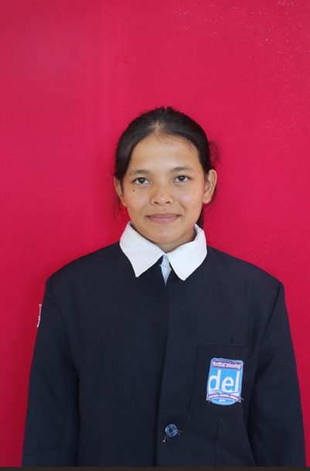
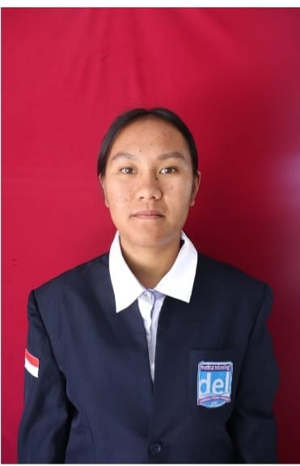
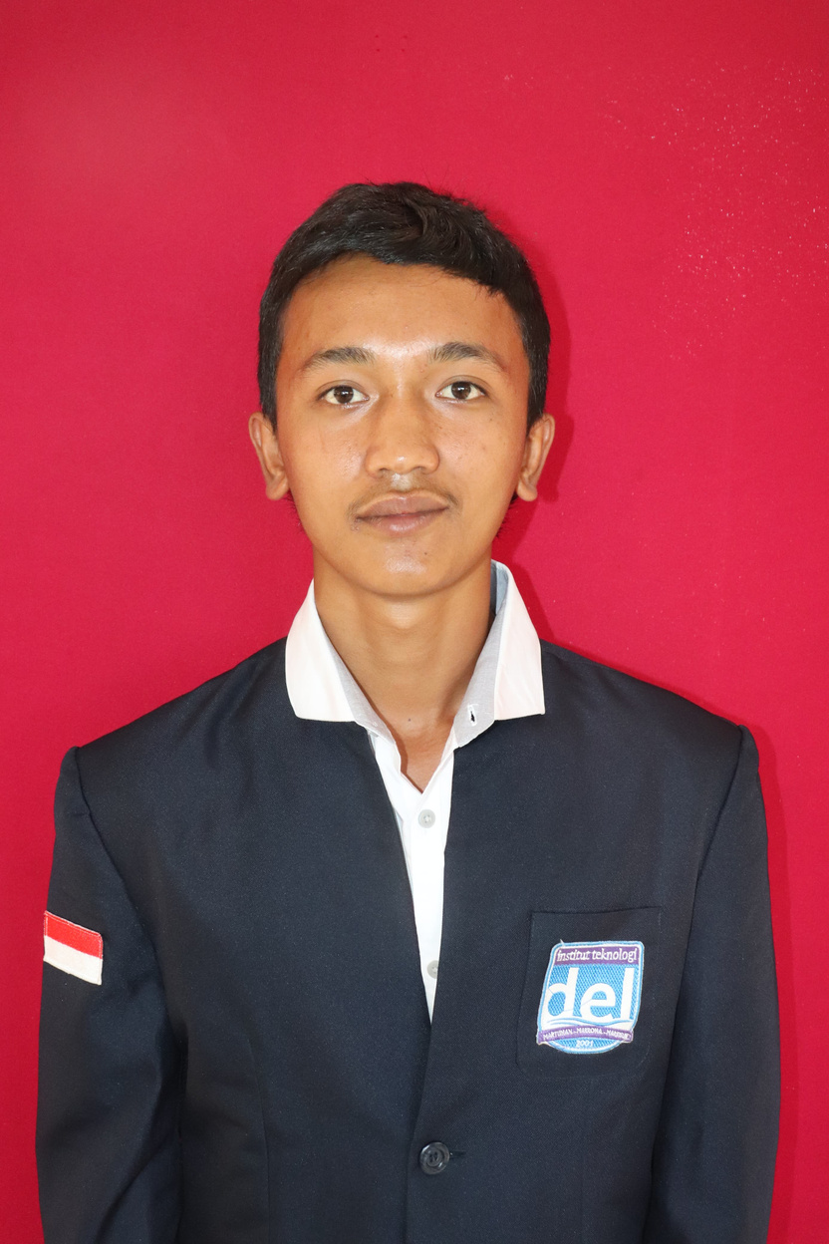
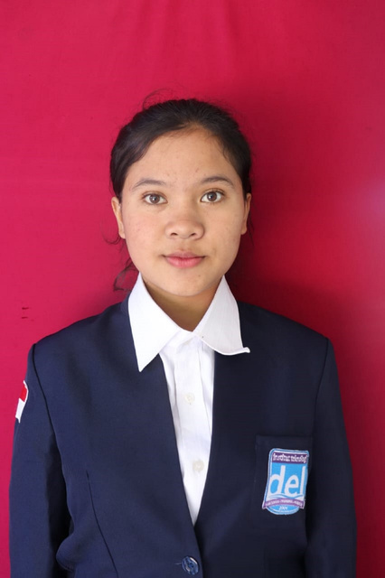
INSTITUT TEKNOLOGI DEL
OUR TEAM
13323045
DEALOVA ZEVANYA MANURUNG
13323010
CALISTA YOSEPHIN PANJAITAN
13323043
CHESIA P.M.SILAEN
13323035
GLEN RIFAEL SITUMORANG
02

Slide 3
INSTITUT TEKNOLOGI DEL
OUTLINE
  BACKGROUND
  PURPOSE
  SCOPE AND LIMITATIONS
  TARGET SYSTEM
  HARDWARE DESIGN
  CONCLUTION
  DEMO
  Q & A
03

Slide 4
INSTITUT TEKNOLOGI DEL
BACKGROUND
  Feeding is not scheduled consistently, leading to growth disorders, nutritional deficiencies, and decreased livestock productivity.
  Feed stock monitoring is still done visually, which risks miscalculations and sudden feed shortages.
  Dependence on the presence of farmers and manual labor causes delays in feeding, especially during bad weather or high workload conditions.
04

Slide 5
INSTITUT TEKNOLOGI DEL
PURPOSE
Improving the feeding system by implementing an automated schedule-based system that operates without the need for manual intervention from the farmer.
1.1
Facilitates farmers in scheduling feed times through Telegram control and provides notifications when feed stock is running low.
1.2
05

Slide 6
INSTITUT TEKNOLOGI DEL
SCOPE AND LIMITATIONS
Only supports land-based livestock such as poultry and freshwater fish; not suitable for large livestock or pets.
1.1
Requires a stable internet connection; not optimal in areas with poor network coverage.
1.2
Control and notifications are limited to Telegram; not yet available on other platforms.
1.3
05

Slide 7
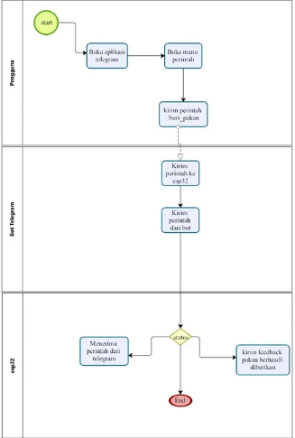

INSTITUT TEKNOLOGI DEL
TARGET SYSTEM
The target system is designed to automate the process of feeding animals through commands sent via the Telegram application. The user opens the app, selects the command menu, and sends the /beri_pakan command to the bot. The Telegram bot forwards this command to an ESP32 device connected to the feeding mechanism. Once the command is executed, the system sends feedback through Telegram to inform the user whether the feeding was successful.
07

Slide 8

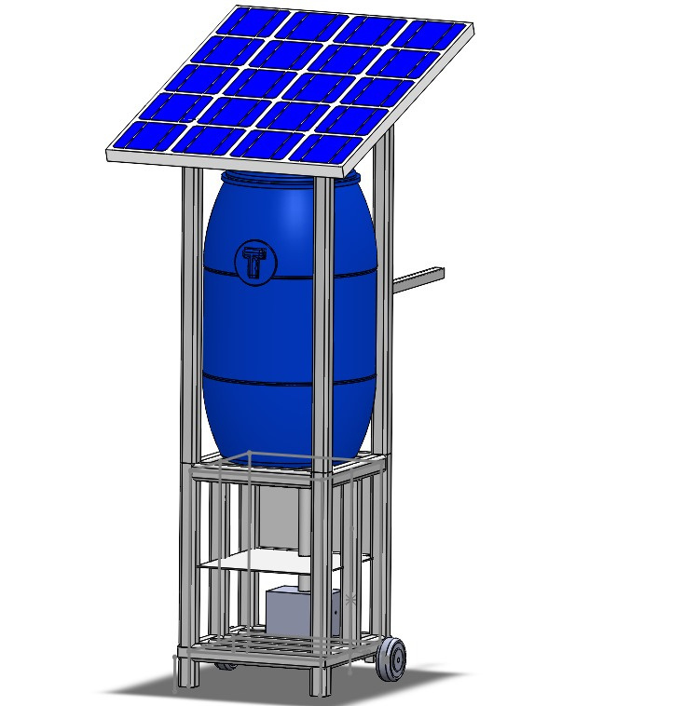
INSTITUT TEKNOLOGI DEL
HARDWARE DESIGN
The solar panel is connected to a Solar Charge Controller (SCC), which regulates and converts solar energy into direct current (DC) electricity, then stores it in a battery. Power from the battery is then distributed through the Solar Charge Controller to various loads, such as the ESP32, motors, sensors, relays, and step-down modules. Feed is stored in a drum and dispensed through an automated channel controlled by a motor, then directed through a pipe and thrown to the livestock feeding area using a turbine.
08

Slide 9
INSTITUT TEKNOLOGI DEL
CONCLUSION
  eFeeder is an automatic feeding system based on IoT technology.
  It improves efficiency, reduces errors, and simplifies feed management.
  Has potential for further development with features like automatic scheduling and notifications.
07

Slide 10
INSTITUT TEKNOLOGI DEL
DEMONSTRATION
https://youtu.be/S7EEEewG4fY?si=xTPcRubx-do_V7bR
07

Slide 11
INSTITUT TEKNOLOGI DEL
Q & A
ANY QUESTIONS?
07

Slide 12
INSTITUT TEKNOLOGI DEL
THANK YOU
11

